Slide 1
INFO7275 38035 Advanced Database Management Systems SECTION 01 - Spring 2017
-Piyush Saxena

Slide 2



Linus Torvalds

Slide 3
GITHUB:
Web-based version control
Home to 20 million users
Hosts 57 million repositories
LINUX:
Uni-like Operating System
Free and open source
Estimated over 90 million users of Linux world-wide

Slide 4
Why this dataset?
The torvalds/linux has the maximum number of commits out of all the 57 million repositories!
The Torvalds/linux repository currently has over 660K commits
Data generated using :
GIT Bash commands
GIT Hub API’s

Slide 5
Implemented
MapReduce:
Summarization Pattern – Numerical Summarization Pattern
MapReduce Chaining of Numerical Summarization Pattern and Top K Pattern
Filtering Pattern – Distributed Grep
Summarization Pattern – Counting with Counters
Data Organization Pattern – Partitioning Pattern
HBase Analysis
Hive Analysis
Pig Analysis
Sentimental Analysis
Mahout Recommendation Engine
Phoenix Analysis
Squirrel Integration
Neo4J Graph
Power BI Visualization

Slide 6
MapReduce - Numerical Summarization Pattern – Calculating number of commits per user
Use Case:
Number of Commits on the repository per User
Input Format:
commit hash | parent hash | Author name | Author Email | Author Date | Committer Name | Committer Email | Committer Date | Subject | Body
Output:

Slide 7
MapReduce Chaining of Numerical Summarization Pattern and Top K Pattern
Use Case:
Find the top 5 committers for this repository
Input Format:
commit hash | parent hash | Author name | Author Email | Author Date | Committer Name | Committer Email | Committer Date | Subject | Body
Output:
Linus Torvalds 22523
David S. Miller 8485
Mark Brown 6690
Takashi Iwai 6028
H Hartley Sweeten 5931

Slide 8
MapReduce Filtering Pattern – Distributed Grep
Use Case:
Find the commits that resolved Defects
Input Format:
commit hash | parent hash | Author name | Author Email | Author Date | Committer Name | Committer Email | Committer Date | Subject | Body
Output:
000a7d66ec30898f46869be01ab8205b056385d0 Patrick Palka 0097875bd41528922fb3bb5f348c53f17e00e2fd Eric W. Biederman 00a537b8204c7360852379b4d56adbeedecc9bb9 Andrew Vasquez 06cf35f903aa6da0cc8d9f81e9bcd1f7e1b534bb Myron Stowe 073a625f0b80fb7613220a56375b0f3d2831af1b Joe Perches 07bedca29b0973f36a6b6db36936deed367164ed Alex Chiang 0978e012cfbaca8bd312933e98cdea2d11778e11 Joe Perches
…..

Slide 9
MapReduce Summarization Pattern – Counting with Counters
Use Case:
Counting the number of Events such as Create Event, Fork Event, Issue Comment Event, Push Event and Watch Event
Input Format:
{
"id": "5655789255",
"type": "ForkEvent",
"actor": {
"id": 817874,
"login": "imirkin",
"display_login": "imirkin",
"gravatar_id": "",
"url": "https://api.github.com/users/imirkin",
"avatar_url": "https://avatars.githubusercontent.com/u/817874?"
}
Output:

Slide 10
MapReduce Data Organization Pattern – Partitioning Pattern
Use Case:
Partition Issues created by users on the basis of year
Input Format:
{
“type": “Issue”,
"state": "open",
"locked": false,
"assignee": null,
"assignees": [],
"milestone": null,
"comments": 1,
"created_at": "2017-04-07T02:02:52Z",
"updated_at": "2017-04-07T02:05:07Z",
"closed_at": null
}
Output:
Data is partitioned into 4 partitions for 2013, 2014, 2015, 2016 and 2017 parts

Slide 11
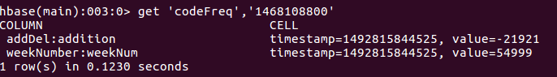
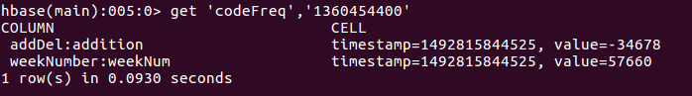
HBase Analysis
HBase table created using command:
create 'committers', 'hash', 'author', 'committer', 'message‘
Data Loaded into HBase from HDFS using command:
hbase org.apache.hadoop.hbase.mapreduce.ImportTsv -Dimporttsv.separator="," -Dimporttsv.columns="HBASE_ROW_KEY,hash:commit_hash,hash:parent_hashes,author:author_name,author:author_email,author:author_date,committer:committer_name,committer:committer_mail,committer:committer_date,message:subject,message:body,message:commit_notes" committers hdfs://localhost:9000/hbase/All_Commits.txt
Output:

Slide 12
Hive Analysis
Hive table created using command:
CREATE TABLE commits(commit_hash STRING,parent_hashes STRING,author_name STRING,author_email STRING,author_date STRING,committer_name STRING,committer_email STRING,committer_date STRING,subject STRING,body STRING) row format delimited fields terminated by '|' stored as textfile;
Data Loaded into Hive using command:
load data local inpath '/home/piyushsaxena2910/Documents/A.txt' into table commits;

Slide 13
Hive Analysis 1
Use Case:
Find all commits with Null Subjects
Command:
INSERT OVERWRITE LOCAL DIRECTORY '/home/piyushsaxena2910/Documents/NullSubject' select * from commits where subject IS NULL or subject = '';
Output:
48855432047c9de7ea9987349de4c47d48ade8d1,752961a11e847e604aeaaa798cac438c1e671ba4,Eric Dumazet,eric.dumazet@gmail.com,2011-10-24 07:53:03 +0000,David S. Miller,davem@davemloft.net,40840.7777777778,[NULL],PATCH net-next] tg3: add tx_droppedCounter
7b7abfe3dd81d659a0889f88965168f7eef8c5c6,e82b3aec8d508d2a925a4c766e97f16b7c4dfb1b,Steve French,sfrench@us.ibm.com,38665.6395833333,Steve French,sfrench@us.ibm.com,[NULL],38665.6395833333
B8dfc6a0a7235aed452c0e376b6feff182a86992,979402b16cde048ced4839e21cc49e0779352b80,Jean Delvare,khali@linux-fr.org,2012-09-06 00:47:05 +0000,David S. Miller,davem@davemloft.net,41159.5388888889,[NULL],PATCH] seeq: Add missing spinlock init

Slide 14
Hive Analysis 2
Use Case:
Find the Most Productive Days of the Week
Command:
INSERT OVERWRITE LOCAL DIRECTORY '/home/piyushsaxena2910/Documents/CommitsByDayOfTheWeek' select count(commit_hash), from_unixtime(unix_timestamp(author_date,'yyyy-MM-dd'),'u') from commits group by from_unixtime(unix_timestamp(author_date,'yyyy-MM-dd'),'u');
Output:

Slide 15
Pig Analysis
Data Loaded Using the following:
commits = LOAD '/pig/A.txt' using PigStorage('|') AS (commit_hash:chararray,parent_hashes:chararray,author_name:chararray,author_email:chararray,author_date:chararray,committer_name:chararray,committer_email:chararray,committer_date:chararray,subject,body:chararray);

Slide 16
Pig Analysis 1
Use Case:
Count number of Commits per day since 2005
Command:
commits = LOAD '/pig/A.txt' using PigStorage('|') AS (commit_hash:chararray,parent_hashes:chararray,author_name:chararray,author_email:chararray,author_date:chararray,committer_name:chararray,committer_email:chararray,committer_date:chararray,subject,body:chararray);
dateGroup = group commits by author_date;
dateGroupCount = FOREACH dateGroup GENERATE FLATTEN(group), COUNT($1) as cnt;
store dateGroupCount into '/pig/output';
Output:

Slide 17
Pig Analysis 2
Use Case:
People from which Organization made the Maximum Contributions to this Repo
Command:
sub_domain = FOREACH commits GENERATE SUBSTRING(author_email,(INDEXOF(author_email, '@',0))+1,(int)SIZE(author_email)) as domains, commit_hash;
sub_domain_group = group sub_domain by domains;
sub_domain_count = FOREACH sub_domain_group GENERATE FLATTEN(group), COUNT($1) as cnt;
sub_domain_count_sort = ORDER sub_domain_count BY cnt DESC;
store sub_domain_count_sort into '/pig/output';
Output:
gmail.com 63123 linux.intel.com 11984 google.com 6144
intel.com 37878 ti.com 11750 visionengravers.com 6034
redhat.com 36066 samsung.com 10121 broadcom.com 5794
linux-foundation.org 20440 oracle.com 10042 freescale.com 5535
kernel.org 19025 linux.vnet.ibm.com 8141 opensource.wolfsonmicro.com 4823
linaro.org 16549 davemloft.net 7593 de.ibm.com 4731
suse.de 15200 amd.com 7026 arndb.de 4451

Slide 18
Sentimental Analysis
Intent:
Users comment on Events such as Pull Requests, Issues, Defects, Commits etc
It is interesting to know what their feeling are!
Library Used:
Used the Stanford NLP JAR to get the sentiments of the users
Instead of counting the number of positive and negative words in a sentence, the Stanford NLP code uses the sentence phrases to identify if a sentence is positive or negative
Output:
Positive Count = 126
Neutral Count = 775
Negative Count = 643
Conclusion:
A lot of comments are on bugs which need retesting or require resolution
Users are sometimes not happy with the quality of code and give review comments which are marked negative by the code
Hence, the overall sentiment is negative

Slide 19






Mahout Recommendation Engine
Intent:
GIT Hub allows users to provide reactions like
Library Used:
Apache Mahout libraries
Input Data:
UserID, Issue/Defect/Comment/PullRequest ID, - + - + +
Output:
RecommendedItem [item:124343891, value:4.5]
RecommendedItem [item:19975372, value:4.0]

Slide 20
Phoenix Analysis
Data Loaded Using the following:
CREATE TABLE "CODEFREQUENCY" (pk VARCHAR PRIMARY KEY,"week"."weekNum" VARCHAR,"week"."addition" VARCHAR,"week"."deletion" VARCHAR);
HADOOP_CLASSPATH=$(hbase mapredcp):~/Installs/Hbase/conf/:~/Installs/apache-phoenix-4.10.0-HBase-1.2-bin/ ./hadoop jar ~/Installs/apache-phoenix-4.10.0-HBase-1.2-bin/phoenix-4.10.0-HBase-1.2-client.jar org.apache.phoenix.mapreduce.CsvBulkLoadTool -Dfs.permissions.umask-mode=000 -d $'\t' -t CODEFREQUENCY --input /hbase/Code_Frequency.csv

Slide 21
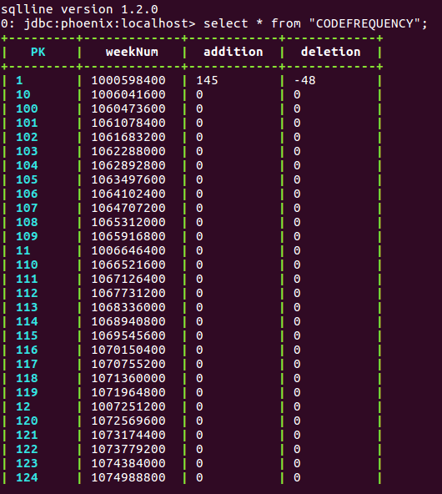
Phoenix Analysis
Use Case:
Number of lines added and deleted every week in the Repository

Slide 22
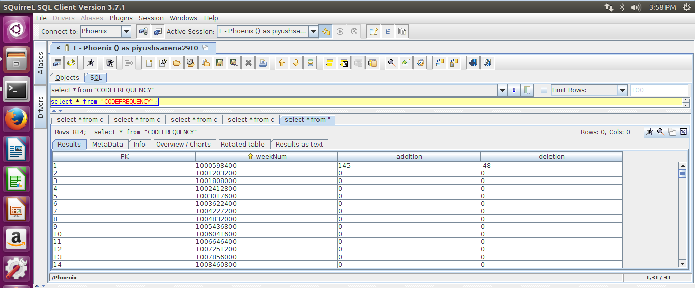
SQuirrel Analysis
Use Case:
Number of lines added and deleted every week in the Repository

Slide 23
Neo4j Analysis
Use Case:
Find the relationships between the top 5 committers and their followers
Code to Insert Data into Neo4j:
LOAD CSV WITH HEADERS FROM "file:///D:/CommittersAndFollowers.csv" AS csvLine
CREATE(committerone:Committer {committerName: csvLine.committer,num:csvLine.srno}),(followerone:Follower {followerName: csvLine.followers,num:csvLine.srno})
MATCH(committerone:Committer {num:csvLine.srno}),(followerone:Follower {num:csvLine.srno})
CREATE (followerone)-[r:FOLLOWS]->(committerone)
RETURN r,followerone,committerone

Slide 24
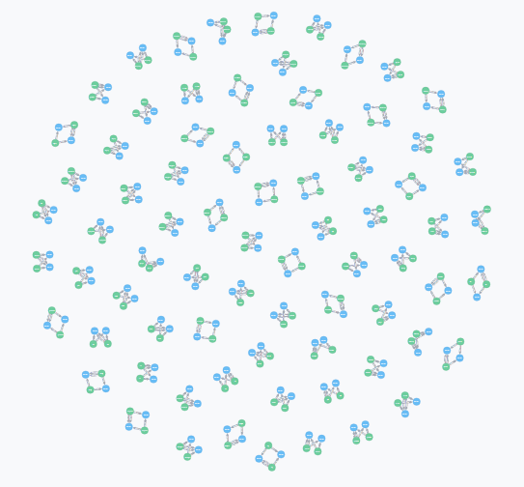
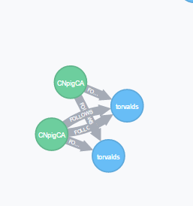
Neo4j Analysis

Slide 25









Thank you

